Slide 1
SOLAR POWERED AUTONOMOUS MULTIPURPOSE AGRICULTURAL ROBOT USING ESP32
Guide:
Dr.B.Sridhar
BY
Gumpa Sireesha
17R21A04D8
B. Ruchitha Reddy
17R21A04G5
Sirikonda Nikitha
17R21A04H3
Paidimalla Shivani
18R25A0431

Slide 2
INTRODUCTION :
Agriculture began thousands of years ago and always plays a crucial as well as a progressive role in developing the nation’s economy. There are some traditional methods such as seed sowing, ploughing and pesticide spraying which are basically expensive and even time consuming. So, the agricultural system in the country needs an active encouragement in order to increase the production of resources with more conscious developments and projects resulting in less manpower and less time consumption.

Slide 3
EXISTING SYSTEM:
The existing system has no only robot which is controlled with Bluetooth and android app but there is no interfacing of different sensors like soil sensor. And it doesn’t have any rechargeable battery.

Slide 4
PROPOSED SYSTEM:
The proposed system consist of microcontroller which is controller for the whole system and solar panel is connected to the battery for storing energy and further it is given to power supply charging circuitry which is providing +5 V for the microcontroller and +12V supply for driving DC motors using L293D motor driver module. ESP32 is connected with microcontroller and wirelessly with Android Smartphone to controlling the whole system.

Slide 5
BLOCK DIAGRAM :
Solar
panel
Rechargeable battery
Left
motor
Micro
controller
Water
pump
Soil
sensor
L293D
IOT
Right
motor
L293D
driver
Dc motor
Dc motor

Slide 6
IMPLEMENTATION:
Solar powered autonomous robot is constructed by programming the hardware components for ploughing, seeding, pesticide spraying and watering.
The solar powered autonomous agricultural robot is placed on the ground, then the robot is controlled by giving the controls through an android mobile application.
The commands are already available in the application we have to connect it through the esp32 module.
The commands for controlling the motor in order to move forward, backward, left and right. The robot also stops as soon as an obstacle is detected and the error message is shown in the android application.
The controls for seeding, ploughing and watering are also available in the application. The soil sensor checks for the moisture in the soil, if the soil is dry the water is sprayed which is also indicated through an LED.
The solar panel is used as a power backup for the robot.

Slide 7
HARDWARE REQUIREMENTS:
Rechargeable battery.
Solar panel.
Microcontroller (ESP32)
Soil sensor.
L293D motor drivers.
DC motors.

Slide 8
SOFTWARE REQUIREMENTS:
Embedded C
Arduino IDE

Slide 9
ADVANTAGES:
This increases the efficiency of seed sowing, pesticide spraying and ploughing.
And also reduces the problem encountered in manual planting.
Requires less man power.

Slide 10
DISADVANTAGES:
System with high cost and high complexity.
Power issue .

Slide 11
SWOT ANALYSIS:
STRENGTH | WEAKNESS | OPPORTUNITY | THREAT
High Efficiency | High cost and complexity | Agricultural Sector | Damage to device may lead to wrong operation.
Requires less man power | Power issue | Local farming | Power problem may arise due to absence of sun for a long duration .

Slide 12
GANTT CHART:

Slide 13
APPLICATIONS:
These multipurpose agricultural robots are mainly used in farming lands.
It can also be used in green houses to plough the land and harvesting can also be done.
It can satisfy the need of various activities like seed sowing, ploughing the land for cultivating.
These robots also result in an active utilization of solar power which can result in effective and efficient productivity of resources.

Slide 14
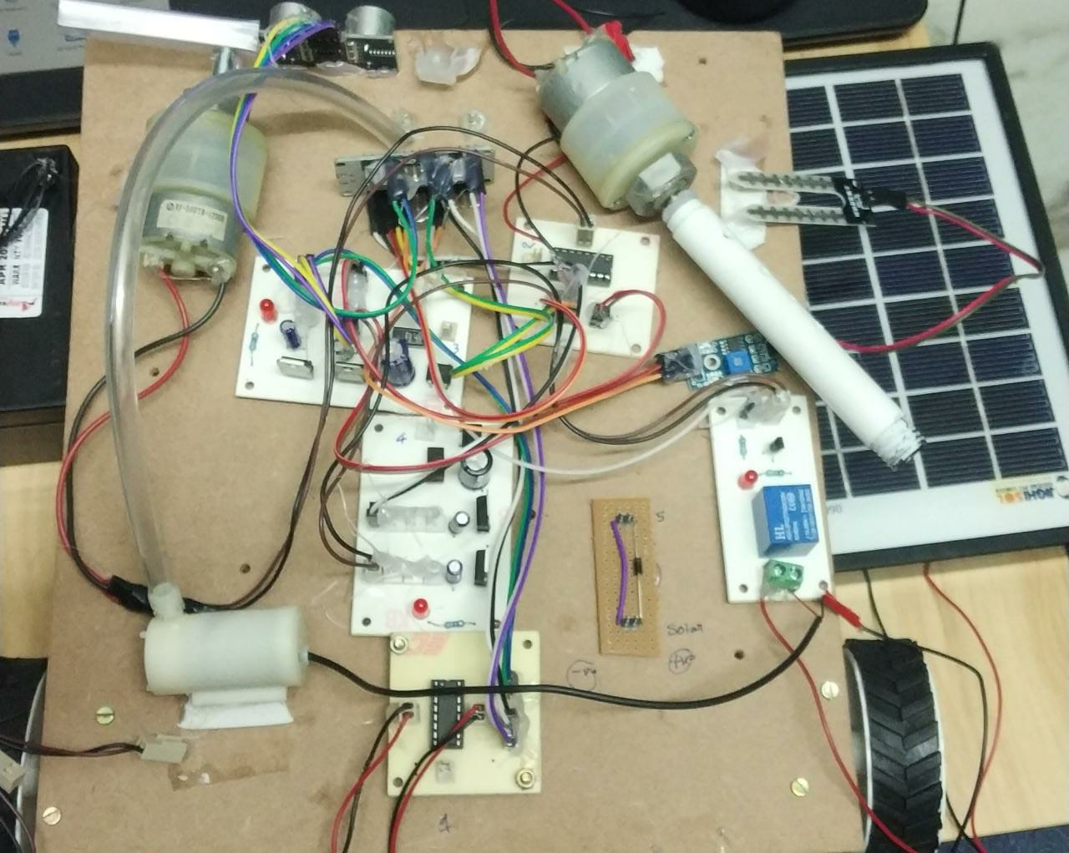
RESULT:

Slide 15
FUTURE SCOPE:
The main future ability of this project is to look for a stable and constant growth with comfortable and repeatable tasks where all the procedures are established internally which can also be monitored from time to time with a inbuilt camera and this major ability leads to a desirable result.

Slide 16











THANK YOU

